Slide 1
Gaussian Flow Matching
Notes:
Speaker A: Welcome everyone to this session, where we will present the overview and details shown on this opening slide.
Speaker B: This meta information establishes the necessary context regarding authorship and timing for our discussion today.
Speaker A: With that established, we will jointly walk through the subsequent sections to ensure all key points are covered, so let's begin with the first analysis.

Slide 2
Diffusion vs Flow
Generative modeling maps Gaussian to data. Diffusion dominates via modality-independent formulation. Tricks ensure scalability and sampling.
Diffusion reverses noisy stochastic trajectories, challenging few-step sampling. Flow Matching uses regular trajectories for efficient few-step sampling.
Diffusion and Flow Matching are theoretically two sides of the same coin. This unification helps practitioners leverage insights from both methods.
Notes:
Speaker A: Generative modeling involves mapping a simple standard Gaussian distribution to an arbitrarily complex data distribution. Diffusion models have dominated this landscape for four years due to a well-defined, modality-independent formulation.
Speaker B: That dominance comes with a trade-off though since the process requires reversing a noisy stochastic trajectory. Consequently, approximating the sampling process with very few steps remains challenging technically.
Speaker A: Flow Matching excels here by utilizing more regular trajectories during the generation process. This capability allows for efficient few-step sampling, causing it to rapidly gain traction as a better alternative for speed.
Speaker B: Exactly - analysis concludes that despite apparent differences, these approaches are essentially two sides of the same coin theoretically. This unification is the best news for researchers since the methods share underlying mathematical structures and goals.
Speaker A: Understanding this relationship allows practitioners to leverage insights from both without treating them as entirely disjoint technologies. Today we will look at these similarities and differences to facilitate easier adoption and innovation.

Slide 3
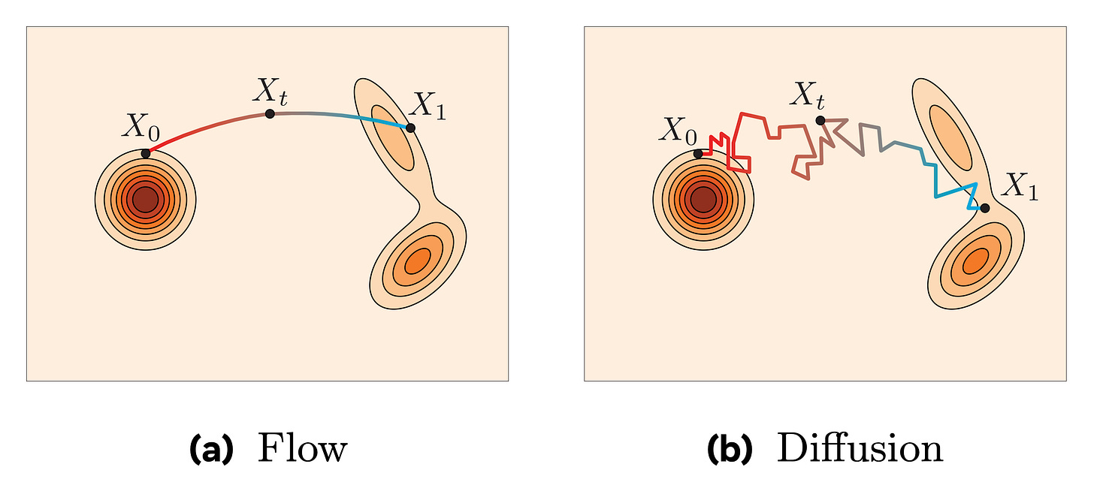
Continuous View
Smooth vs Jagged Paths
Diffusion uses stochastic steps, making jagged paths. Flow matching has deterministic trajectories on contours.
Notes:
Speaker A: We begin by shifting from discrete noising steps to a continuous view where increasing steps approximates a differential equation.
Speaker B: That continuous limit formally defines a probability flow transporting mass between complex data and simple Gaussian distributions.
Speaker A: Flow matching leverages this with linear interpolation, establishing a probability flow that coincides with diffusion when the noise is Gaussian.
Speaker B: Looking at the visual, you can see the stochastic diffusion path is jagged, whereas the flow matching trajectory is smooth and deterministic.
Speaker A: That smoothness is the key takeaway, as deterministic trajectories significantly improve sampling efficiency and stability.

Slide 4
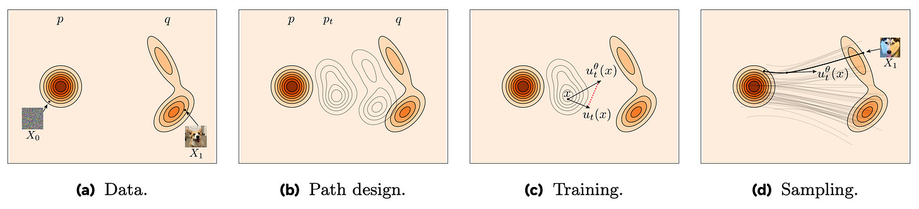
Flow Matching
Velocity Field Training
Predicts velocity via interpolation. Deterministic paths enable fast sampling. View: dist, path, velocity, trajectory.
Notes:
Speaker A: Let's distinguish the objective, where diffusion predicts added noise but flow matching estimates the instantaneous velocity field transporting samples from noise to data.
Speaker B: Exactly, this shift from stochastic noise prediction to deterministic velocity estimation defines the core mathematical distinction between the two generative frameworks.
Speaker A: In the four-panel diagram, you can see we sample a data point and noise, then linearly interpolate between them to obtain an intermediate point for training. The model predicts the ground truth velocity calculated as the derivative of this interpolation path.
Speaker B: And since linear interpolation ensures the path moves at constant speed, the velocity field remains consistent across all time steps. This deterministic trajectory allows for fast sampling using efficient first-order solvers.
Speaker A: So while the objectives differ, both frameworks perturb samples and share identical neural architectures using time indices. This gives us mathematical optimality without sacrificing architectural familiarity.

Slide 5

Inference Flow
Flow Matching Sampling
Noise flows to data via velocity. Integrates equation backward from time one to zero. Euler updates ensure efficiency.
Notes:
Speaker A: Let's examine the inference process where we transform Gaussian noise into target data. Both diffusion and flow matching initiate generation by drawing a single sample from a standard Gaussian distribution.
Speaker B: As the animation illustrates, this noise follows a trajectory toward the data, but the guidance mechanism differs between the two approaches. Diffusion removes noise iteratively while flow matching predicts velocity to move along the path.
Speaker A: For diffusion, the model predicts the clean sample appearance and uses the DDIM sampler to project estimated samples back to lower noise levels. Flow matching reduces sampling to numerically integrating a differential equation backward from time one down to zero.
Speaker B: Despite these different formulations, practical sampling utilizes a simple first-order Euler update for both methods. This approach yields fast sampling without requiring complex higher-order solvers during the integration steps.
Speaker A: Consequently, running diffusion with DDIM is effectively the same as running flow matching with a linear update. This equivalence allows us to achieve efficient generation regardless of which underlying mechanism we choose.

Slide 6
Diffusion Subset
Flow matching serves as the broader general framework, encompassing diffusion models as a specific subset occurring strictly with Gaussian perturbations.
No fundamental differences exist beyond specific training considerations and sampler choice mechanisms that distinguish the two approaches.
Practical evidence supports using Gaussian noise and straight linear interpolation to simplify implementation without sacrificing performance.
Notes:
Speaker A: This slide summarizes the theoretical relationship between diffusion and flow matching models. Essentially, flow matching serves as the broader general framework that encompasses diffusion models as a specific subset.
Speaker B: Exactly - diffusion appears strictly when Gaussian perturbations are applied alongside a specific noise schedule within that structure. Understanding this hierarchy clarifies why both methods yield similar generative results.
Speaker A: Moving to practical implementation, while flow matching allows broader choices of paths during generation, evidence suggests sticking to standard methods. There is little reason to avoid using Gaussian noise combined with straight linear interpolation for most cases.
Speaker B: That's the key point - this simplifies implementation while maintaining effectiveness across typical use cases without sacrificing performance quality. Ultimately, specific training considerations and sampler choices are what distinguish the approaches rather than the core framework.
Speaker A: So, despite the theoretical flexibility, the practical recommendation is to utilize standard paths for most scenarios. This ensures we maintain effectiveness while keeping the engineering workflow straightforward.

Slide 7
Impact & Adoption
Predicts velocity field directly via modified network output. Simpler to fit with parametric models, improving training dynamics and enabling better scaling of neural architectures.
Major industry releases are shifting to this generative paradigm. Examples include Stable Diffusion 3 adopting this approach and Movie Gen by Meta AI using this modeling method.
Indicates a broader trend occurring in the technical field. Practitioners focused on generative modeling should update their technical toolbox soon to include these methods.
Notes:
Speaker A: The primary technical contribution here is modifying the network output to predict the velocity field directly. This specific output format is generally simpler to fit with parametric models compared to alternative approaches.
Speaker B: And this matters because that simplification leads to significant improvements in training dynamics and allows for better scaling of the architectures.
Speaker A: We are seeing major industry model releases actively shift towards this generative modeling paradigm, including Stable Diffusion 3 and Movie Gen by Meta AI.
Speaker B: This shift signals a broader trend in the field that goes beyond isolated research experiments.
Speaker A: Consequently, updating your technical toolbox to include these methods is worth the effort.

Slide 8
Thank you!
Notes:
Speaker A: This brings us to the conclusion of our presentation today.
Speaker B: It has been a privilege to share this work with you.
Speaker A: Thank you all for your time and attention.

